Slide 1
Capstone Project – 3 Health Insurance Cross Sell Prediction
●
●
Presented By:
Debashish Das Lucky Jain Vivek katolkar

Slide 2
Data Methodology :
PHASE 1
PHASE 2
PHASE 3
PHASE 4
PHASE 5
Business Domain
Data Processing
Exploratory Data Analysis (EDA)
Model Selection & Model Evaluation
Conclusion
Flow

Slide 3

Problem Statement :
Our client is an Insurance company that has provided Health Insurance to its customers now they need your help in building a model to predict whether the policyholders (customers) from past year will also be interested in Vehicle Insurance provided by the company.
An insurance policy is an arrangement by which a company undertakes to provide a guarantee of compensation for specified loss, damage, illness, or death in return for the payment of a specified ‘Premium’.
A ‘Premium’ is a sum of money that the customer needs to pay regularly to an Insurance company for this guarantee.

Slide 4

Key Level Highlight :
Objectives
Build a system that can help company to predict potential customer who interested on having vehicle insurance and identify best feature to improve positive responses from customers toward vehicle insurance.
Business Metrics
Response rate
Goals
To predict customers who own health insurance will be interested in subscribing to vehicle insurance.

Slide 5
Overview Our Dataset :
Variable | Gender | Age | Driving License | Region Code | Previously Insured | Vehicle Age | Vehicle Damage | Annual Premium | Policy Sales Channel | Vintage
Type | Categorical | Numerical | Categorical | Categorical | Categorical | Categorical | Categorical | Numerical | Categorical | Numerical
Values | Male Female | 20 … 85 | Yes No | 0 to 52 | Yes No | < 1 year 1-2 years > 2 years | Yes No | 2,630 … 540,165 | 1 … 163 | 10 … 299
Description | Gender | Age | Does customer have a driver’s license? | Customer region | Does customer have vehicle insurance? | Age of customer’s vehicle | Does customer’s vehicle have damage? | Health insurance annual premium | Sales channel customer belongs to | How long customer has been associated with company?
Response
Categorical
Yes No
Is customer interested in vehicle insurance?

Slide 6
Data Cleaning:
The data set consists of around 381109 entries and 12 columns.
Out of this, there were 269 duplicated entries present, which have been dropped.
The dataset doesn't have any feature with Null Values!!!

Slide 7

PRE-PROCESSING
Data Collection
Data Cleansing
Feature Engineering
Feature Encoding

Slide 8
Exploratory Data Analysis

Slide 9
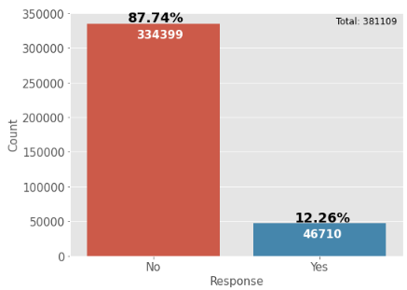
Target Variable :
Customers who responds = 46710 (12.26%)
Customers who aren’t responds = 334339 (87.74%)

Slide 10
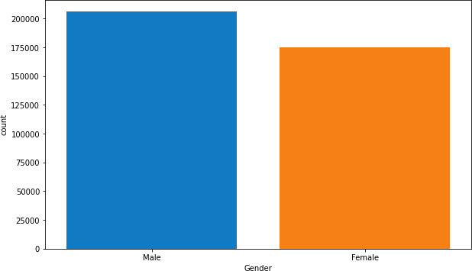
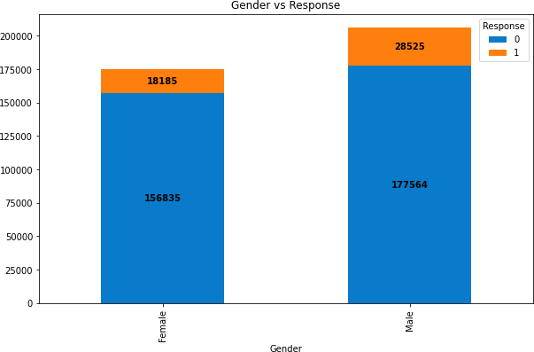
The Male Policyholders are slightly more than the Female policyholders.
Male customers' proportion is higher in both types of
response than Female customers.

Slide 11
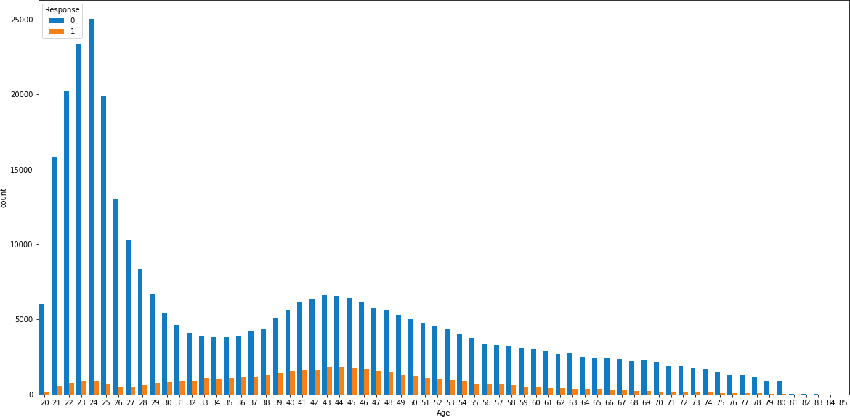
The Age of policyholders ranges from 20 to 85.
People aged between 30-57 are more likely to be interested in the insurance policy.

Slide 12
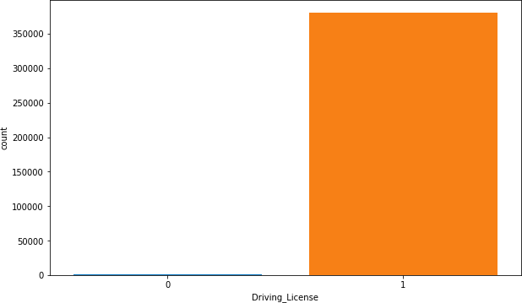
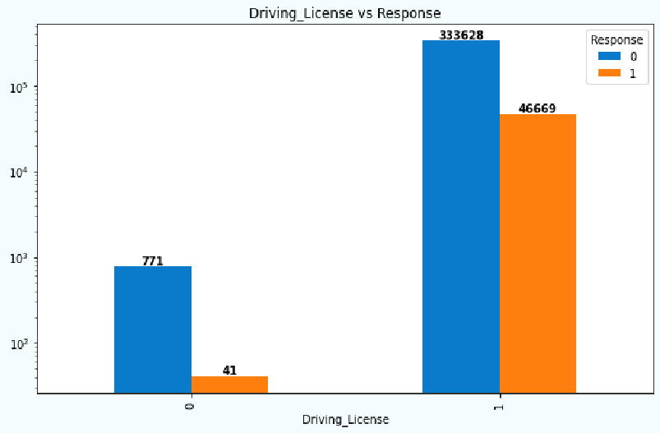
Maximum policyholders acquire a driving license.
From the customers who have D.L., only 1 2. 3 % of them are interested in insurance policy.
From the above plot,we can observe that 41 customers who do
not have a driving licence are also interested in the insurance policy.

Slide 13
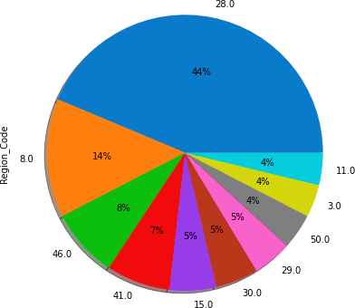
Region 28 is the largest contributor to people using insurance.

Slide 14
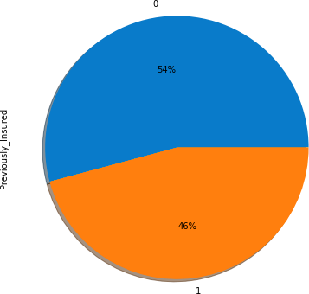
Around 5 4% of the customers does not have the vehicle insurance while 4 6% of the customers already have it.

Slide 15
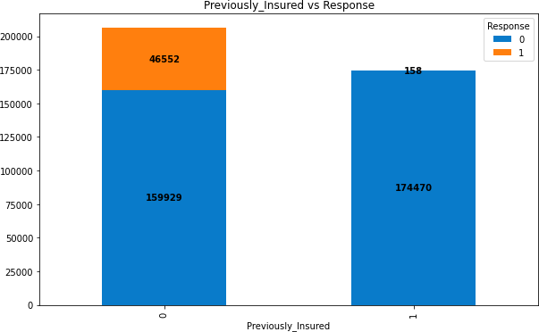
Of the customers who were previously not insured, 46552 of them are interested in the policy, while the majority of them are not interested.
And also, among the customers who were previously insured,
the majority of them are not interested in the policy.

Slide 16
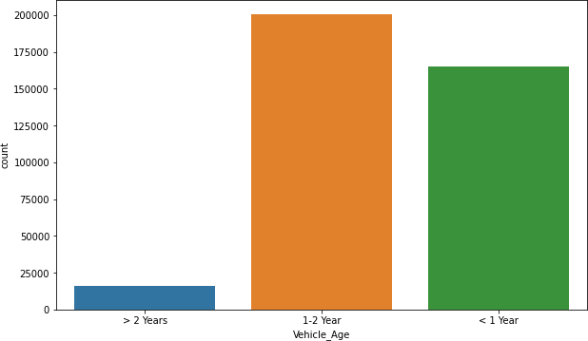
Most of the customers have vehicles that are 1-2 years old.
Very few customers have a vehicle more than 2 years old.

Slide 17
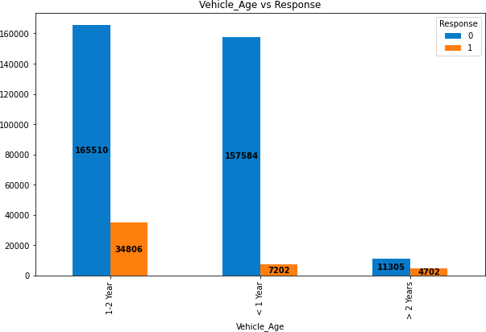
The majority of customers interested in the insurance policy have vehicles that are 1 to 2 years old, followed by those with vehicles that are less than 1 year old.
Very few customers are interested in the policy if they have more than two-year-old vehicles.

Slide 18
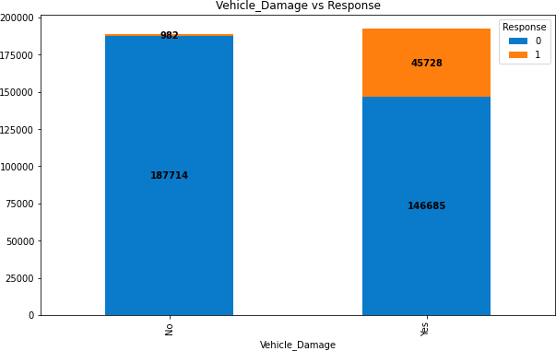
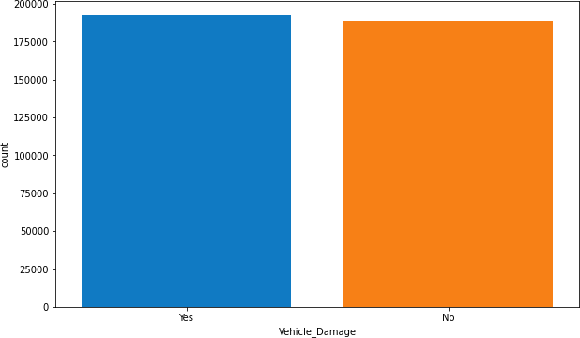
The plot shows that the number of customers who damaged their vehicles and the ones who didn't are almost equal.
If we observe the number of customers who are interested in the insurance policy, then the maximum number of them are those who have had vehicle damage in the past.

Slide 19
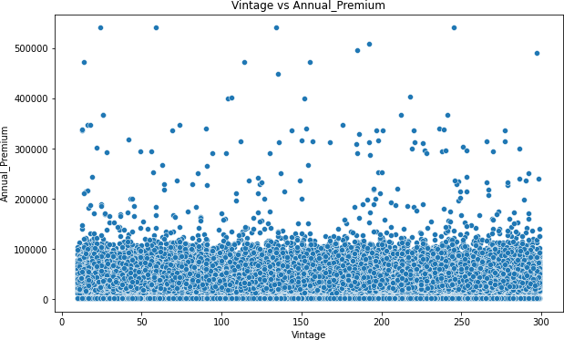
It seems that the number of days the customer is associated with the company does not affect the amount of Annual Premium.

Slide 20

Interpretation and Insight From EDA :
The proportion of customer not responding at 87.7%. It shows that, customers are not interested about the idea of having vehicle insurance.
Majority age customers who interested in subscribing vehicle insurance at region 28 are between 30 - 57 years old.
Region 28 is the largest contributor to people using insurance and also have largest positive respond than other regions, but have largest road accident than other regions.

Slide 21
Feature Engineering :
The binary features ‘Gender’ and ‘Vehicle Damage’ are encoded in the form of 0 and 1 for the response No and Yes respectively.
One Hot Encoding is performed on the ‘Vehicle_Age’ Feature.
The columns ‘Vehicle_Age_1-2 Year’ and ‘Vehicle_Age_> 2 Years’ have been merged as follows:
x ['Vehicle_Age > 1 Year'] = x ['Vehicle_Age_1-2 Year'] + x ['Vehicle_Age_> 2 Years']
The multicollinearity from the features is removed by keeping the VIF value as low as possible.

Slide 22
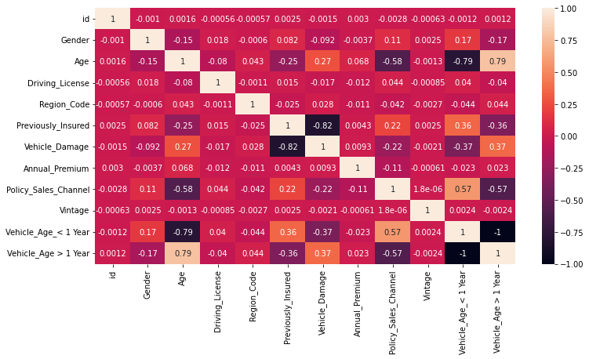
Feature Engineering :

Slide 23
Feature Engineering :
The data has been scaled to improve the model performance using MinMaxScaler.
Some of the features in our dataset are highly imbalanced,
hence to avoid this error, the dataset is balanced using technique
called SMOTE(Synthetic Minority Oversampling Technique)

Slide 24

Machine Learning

Slide 25
ML Models Used :
Logistic Regression
Random Forest Classifier
XGBoost Classifier
Naïve-Bayes Classifier
Hyper-Parameter Tuning metod used:
1. GridSearch CV

Slide 26
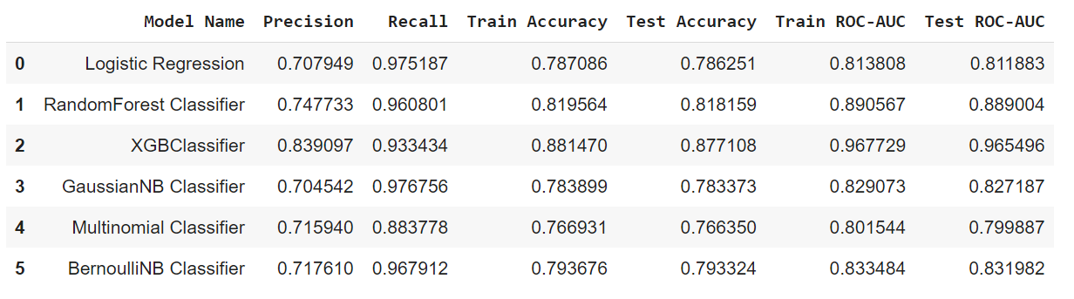
Results obtained after Training the Dataset :
After training the models and comparing the results, it can be said that the XGBoost
Classifier model has performed better than the other models.

Slide 27
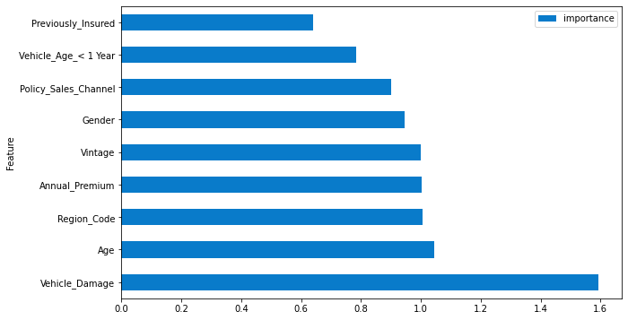
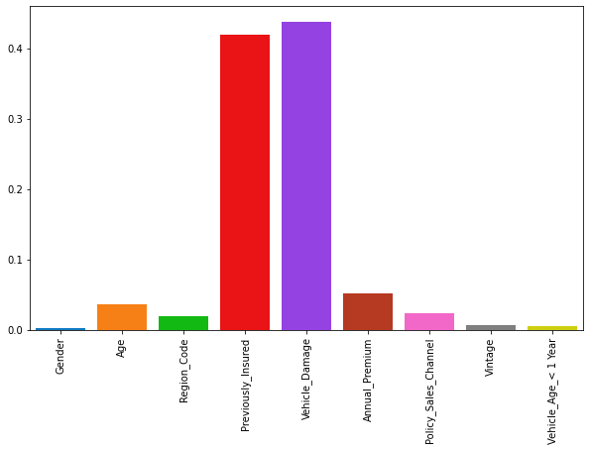
Feature Importance:
Most important feature according to Logistic Regression
Model is Vehicle Damage followed by Age
Previously Insured and Vehicle Damage are most important features according to XGB Model.
Logistic Regression
XGBoost Classifier

Slide 28
Conclusion:
After loading the dataset, cleaning the data, performing EDA,
Feature Engineering and after feature selection, Models are built.In terms Training and Testing Accuracy and ROC-AUC score, XGBoost Classifier gave the best results.
Vehicle_damage and Previously_Insured came out as the most important features for the model.
We will choose in this case is XGBoost Machine Learning. This model is able to predict the label of the target customer who is response and not response at an recall model with value 93% and Roc-AUC score at 96%.
This means our model can improve our response rate for predicting customers who interested in subscribing vehicle insurance

Slide 29

Thank You

